Slide 1
Oxford University Press – publisher supporting libraries and research communities
Marcin Dembowski– marcin.dembowski@oup.com
October 2015
Tomsk

Slide 2
Agenda for the session
About OU & OUP
Products
How to Get Published
To ‘demystify’ the publishing process
To provide tips, insider knowledge and key questions to maximize your chances of publication
Q&A session: ask anything!
Follow-up: I’m always available to help
To get you sharing your knowledge, i.e. to get you writing

Slide 3

The University of Oxford
Overview
The oldest university in the English speaking world.
It is a collegiate research based institution.
Notes:
The University is made up of a variety of institutions, including 38 constituent colleges and a full range of academic departments which are organised into four Divisions. All the colleges are self-governing institutions as part of the University, each controlling its own membership and with its own internal structure and activities.

Slide 4
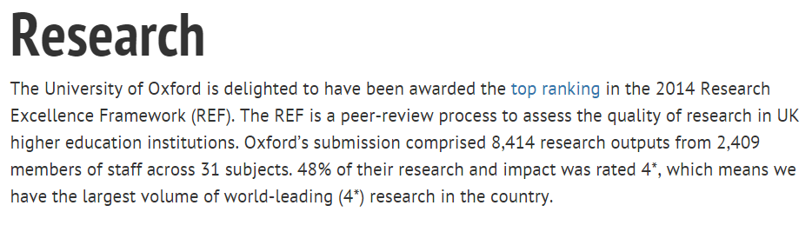

Oxford University and Research
Where does it rank?
Notes:
Result table - http://www.ox.ac.uk/research/research-impact/ref-2014-results/results-table
Summary of the results - http://www.ox.ac.uk/research/research-impact/ref-2014-results

Slide 5

Scholarships at Oxford University
Graduate Scholarships
University Wide Scholarships
College Scholarships
Department Scholarships
External
Scholarships
Notes:
http://www.ox.ac.uk/admissions/graduate/fees-and-funding/graduate-scholarships/external-scholarships
These scholarships are generally fully-funded, covering all your fees and living expenses, although some awards are smaller. Most have eligibility restrictions, for example, based on your country of ordinary residency or your course of study. The vast majority are only open to candidates who are applying to start a new graduate course of study.
To be eligible for consideration for the majority of these scholarships, applicants must be successful in being offered a place on their course after consideration of applications received by the relevant January deadline for their course.

Slide 6
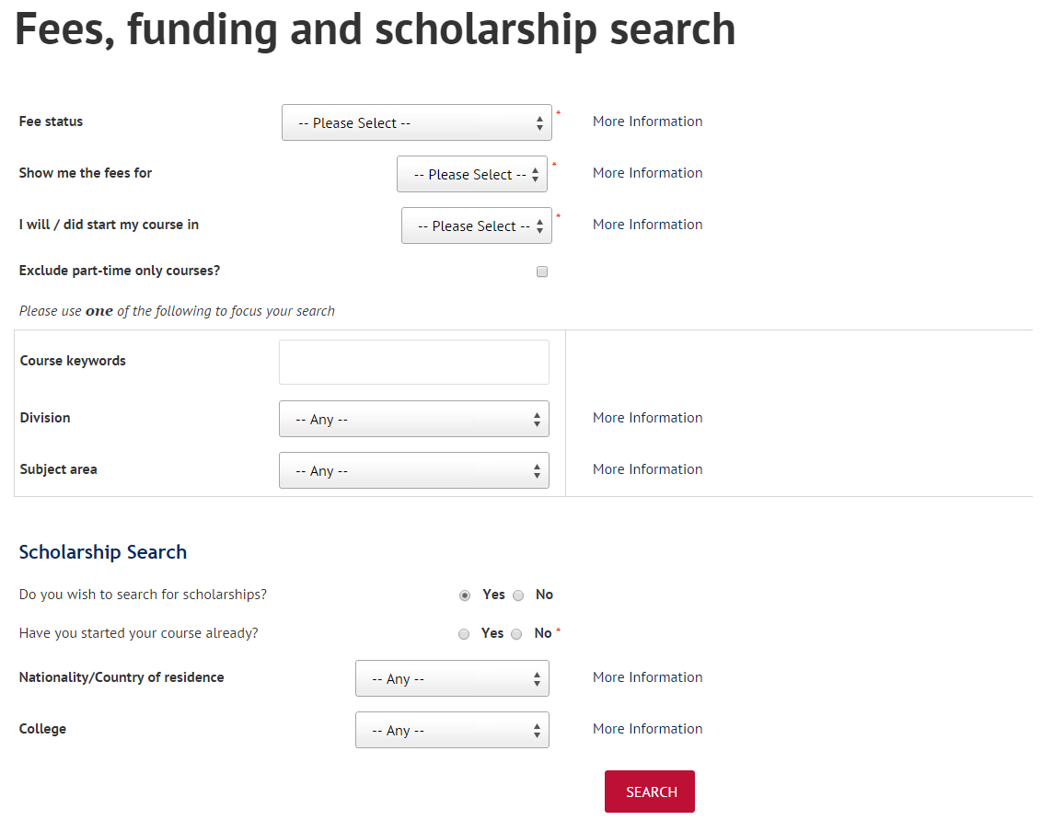
Scholarships
Tools to search for relevant scholarship
http://www.ox.ac.uk/admissions/graduate/fees-and-funding/fees-funding-and-scholarship-search/search
Notes:
Fees, funding and scholarship search: http://www.ox.ac.uk/admissions/graduate/fees-and-funding/fees-funding-and-scholarship-search/search
This tool offers you the ability to look for relevant scholarships in the field of your interest.

Slide 7
Oxford University Press

Slide 8

Our Mission
Oxford University Press is a department of the University of Oxford. It furthers the University's objective of excellence in research, scholarship, and education by publishing worldwide.
John Fell
Clarendon Presentation—Tim Barton (November 2011)
Notes:
OUP is a department of the University.
Our mission is to further the University’s objectives of excellence…
The Press is overseen by a group of Delegates who are appointed from the university’s academic staff.
To give a sense of this special relationship: Delegates meet fortnightly, to review and approve projects.
That meeting is chaired by the Vice Chancellor (president) of the University.
Our chief executive, Nigel Portwood’s formal title is secretary to the Delegates.
Support the University’s mission by publishing the very best academic work, and high quality teaching materials. Both of which support education and the dissemination of knowledge
Other activities to support learning and literacy. For instance, run a major litareature festival each year in Karachi Pakistan
Our surplus on sales goes back to the university for projects and scholarships.

Slide 9


A Very Short Introduction
Origins date back to 1478
Largest university press
25th largest publisher in the world
6,000 employees worldwide
Over 5,000 titles per year, and 300 journals
Notes:
With origins dating back to 1478, when first book published at university
OUP is among the oldest university presses in the world
Picture of the delegates meeting in Clarendon building, where continuously meeting since 18th century.
Picture of the Press’s main office in Oxford
It is also the largest university press in the world
In fact, OUP is bigger than all other English language university presses in the world put together
Including the 110 UPs in the US, PLUS Cambridge.
Employ 6,000 people worldwide with major publishing offices in Oxford, New York, and Dehli.
Publish close to 7,000 new titles each year, 300 journals, and a range of online products.
Publish in more than 40 languages, and in a variety of formats– print and digital.
Sell more than 110 million units each year, and most of those sales are outside of the UK.
OUP accounts for 55% of the University Press market.
While giant by university press standards, we are a mid-sized publisher within the wider industry.
According to a global ranking of the Publishing industry, we’re the 25th largest.
About $1 billion in sales per year.

Slide 10



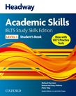






Our publishing areas…
Global Academic
English Language Training
International Education
Notes:
One press, but made up of 3 distinct publishing units.
Academic unit:
Dictionaries (including OED)
Journals program
Research monographs
Subject Reference
English Language Training
Textbooks used in teaching English
Range of print and digital offerings used worldwide
Education
Student teaching tools
Print textbooks and online products
Used worldwide, for teaching in English
Local language material produced in branch offices

Slide 11
Oxford University Press
Products

Slide 12
Support to Students Researchers and Academics
OUP in Humanities
Reference Materials
ODO, OBO, ORO
Framing the question for exploration & reflection
Scholarly Resources
OHO, UPSO, Journals, Research Encyclopaedias
Build argument & Support with evidence
Topic
Oxford Index
Generating related OUP content to deepen your search
Notes:
Linking our material to a research journey where each of them falls under one category.
The reference material would be: ODO, OBO, ORO
The Scholarly Resources: OHO, UPSO, Journals
The subject specific will vary between reference and scholarly resources because they cover both aspects based on their content.

Slide 13








Each resource provides a vital step on the research journey, from quick fact checking, to reviewing the literature in a field, to keeping up to date with the latest research.
Where do OUP Resources Fit in your Research Journey?
Subject Specific Resources
Notes:
The following slides show how each resource fits into the research journey. Each resource provides a vital step on the research journey, from quick fact checking, to reviewing the literature in a field, to keeping up to date with the latest research.

Slide 14




Presentation Outline
Online Dictionaries

Slide 15
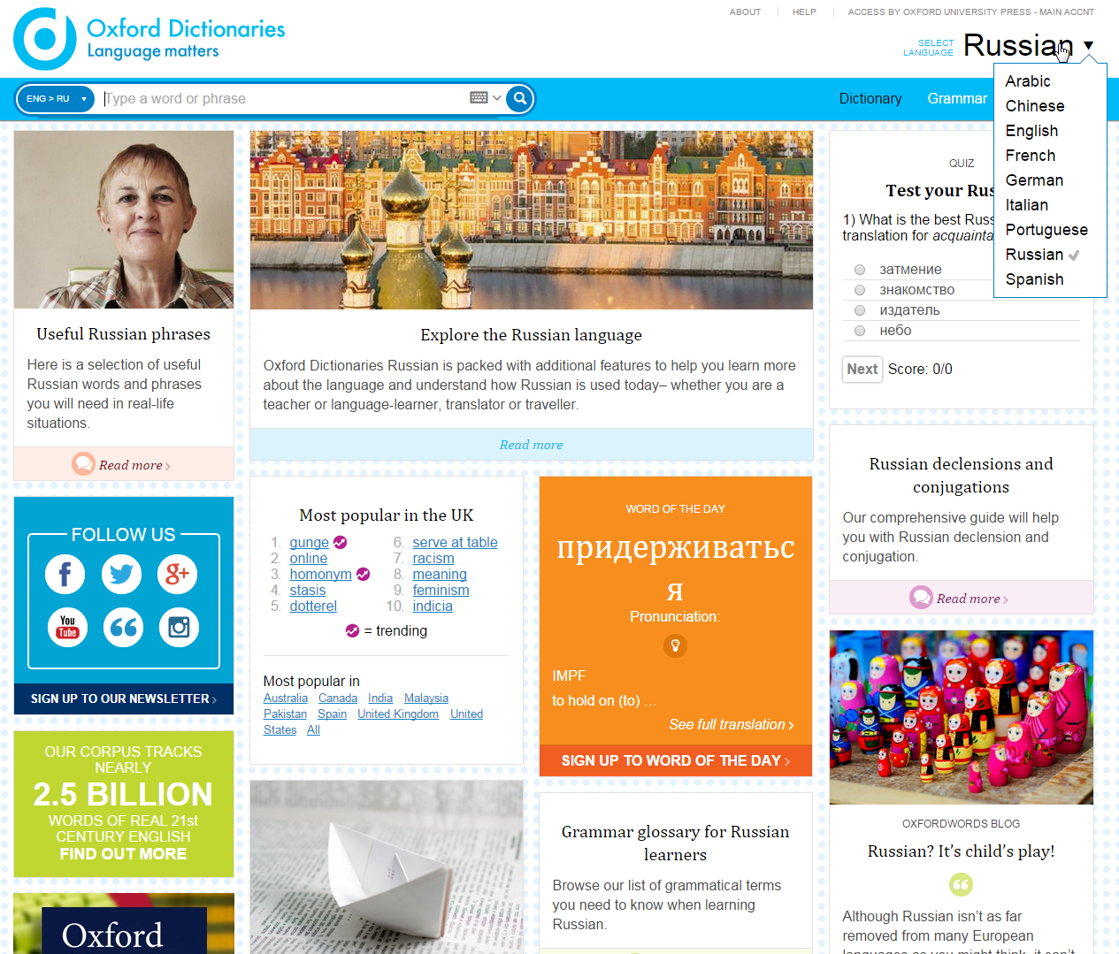
Oxford Dictionaries
If you are learning English as a second
language or wish to expand your
knowledge in Russian, you will be able
to:
*Look at the Explore section to learn more
about writing, the holidays of the country
*You will be able to hear the pronunciation of
words and sentences
*You will be able to transliterate i.e.
type Arabic with Latin characters and the
dictionary recognises the Arabic equivalent
The dictionary re-launched with adding
Russian and Chinese to its content
The introduction of Portuguese as a new
joiner to the site
The increase of the information and
definition within the French, Spanish,
Italian, and German languages
Explore the content
Notes:
1- The dictionary relaunched a week back with adding Russian, Chinese to its content
2- The introduction of Portuguese as a new joiner to the site
3- The increase of the information and definition within the French, Spanish, Italian, and German languages
4- If you are learning English as a second language or wish to expand your knowledge in Russian, you will be able to:
*Look at the Explore section to learn more about writing, the holidays of the country
5- You will be able to hear the pronunciation of words and sentences
6- You will be able to transliterate i.e. type Arabic with Latin characters and the dictionary recognises the Arabic equivalent

Slide 16
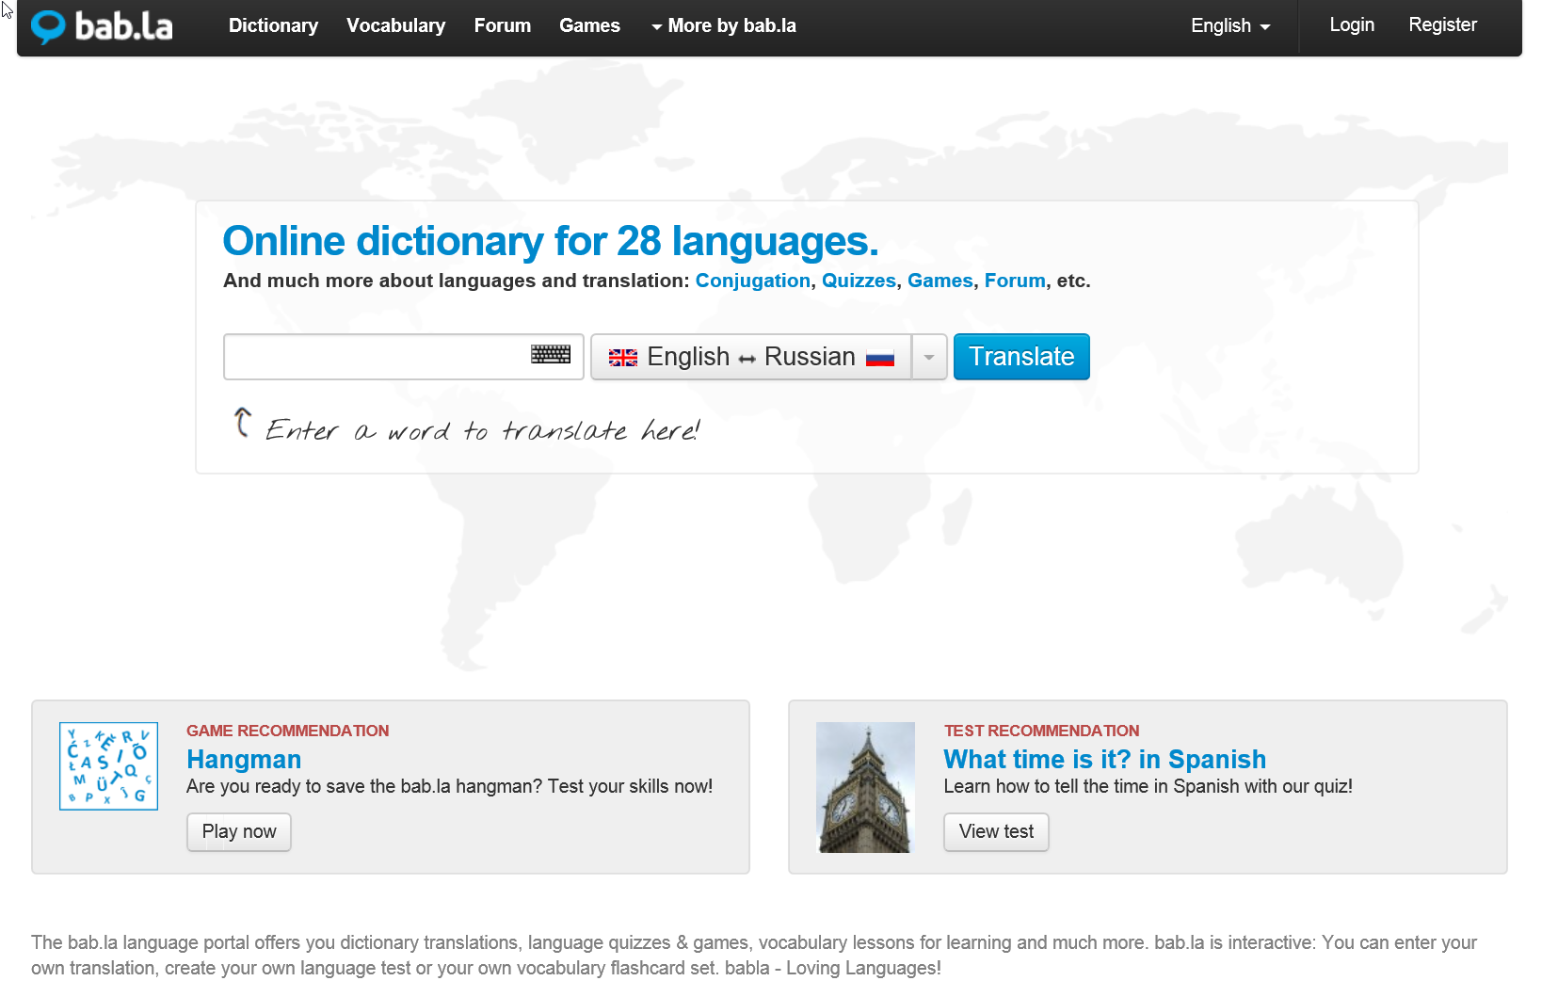

Slide 17
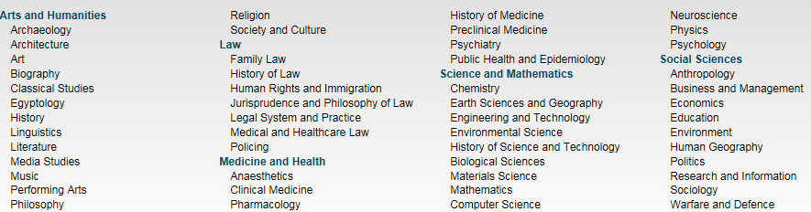
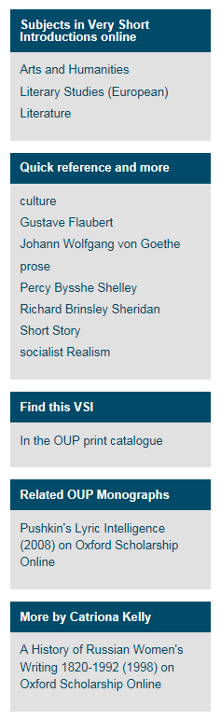
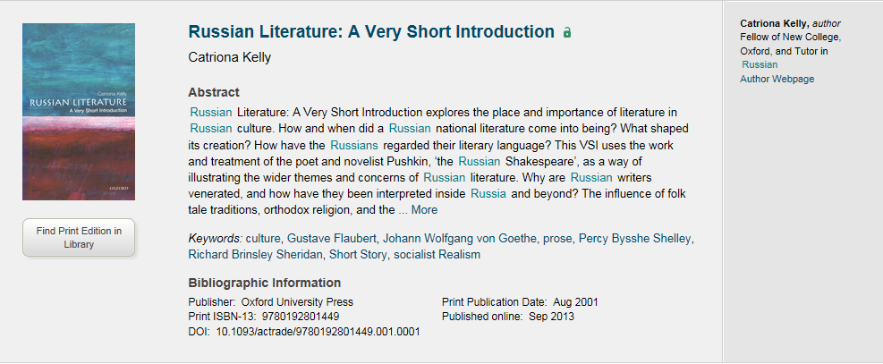
Very Short Introductions
VSI gives you an A-Z about any subject area with simple words to make the subject more approachable especially something like Quantum Physics.
Very Short Introductions offer concise introductions to a diverse range of subject areas
400+ books available
5 Subject Area with 50 different subtopics
Explore the content
The extra material (right of the slide) for every book – videos, blog posts, additional material from other resources (OSO and ORO), additional linking related to the topic or the author.
The author webpage and the ability to locate the physical book in one’s own library
Notes:
In the research journey, these fall within the references because it gives you an A-Z about any subject area with simple words to make the subject more approachable especially something like Quantum Physics.
Very Short Introductions offer concise introductions to a diverse range of subject areas
400+ books available
5 Subject Area with 50 different subtopics
Things to highlight –
The extra material (right of the slide) for every book – videos, blog posts, additional material from other resources (OSO and ORO), additional linking related to the topic or the author.
The author webpage and the ability to locate the physical book in one’s own library

Slide 18
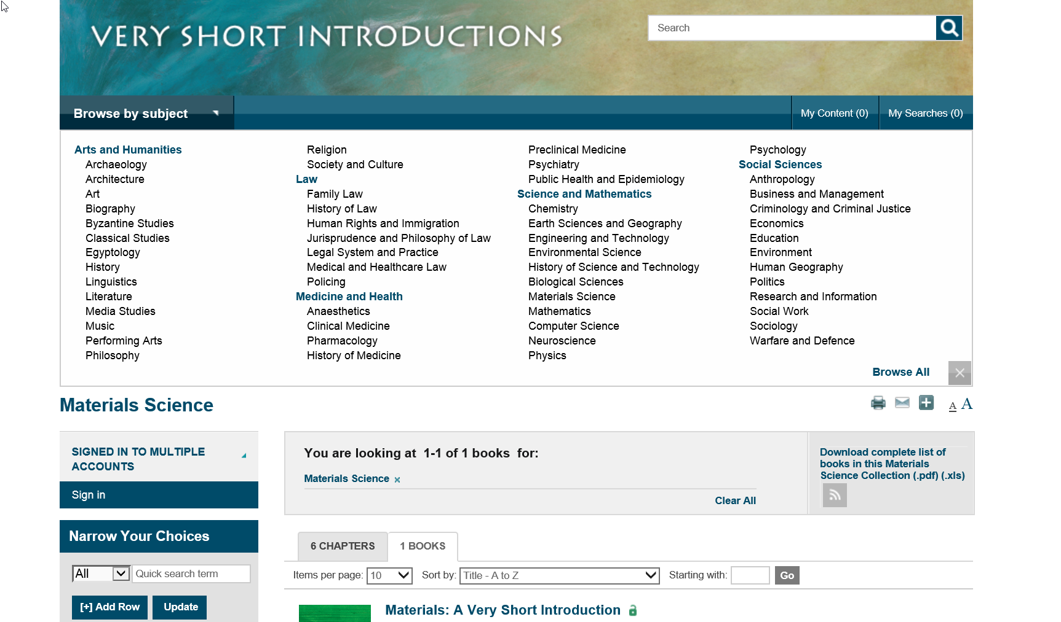

Slide 19
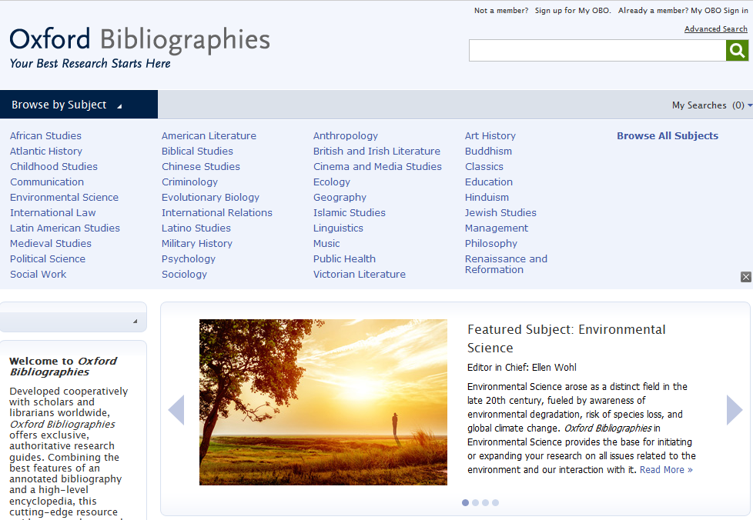
Каждая тема в Oxford Bibliographies объединяет обширную коллекцию статей, касающихся разделов той или иной дисциплины.
В результате получился невероятно мощный новый ресурс, разработанный, чтобы послужить исследователям путеводной нитью в ситуации информационной перегрузки.
Oxford Bibliographies разработан совместно с учёными и библиотекарями из разных стран и содержит эксклюзивные, авторитетные пособия для исследований.

Slide 20
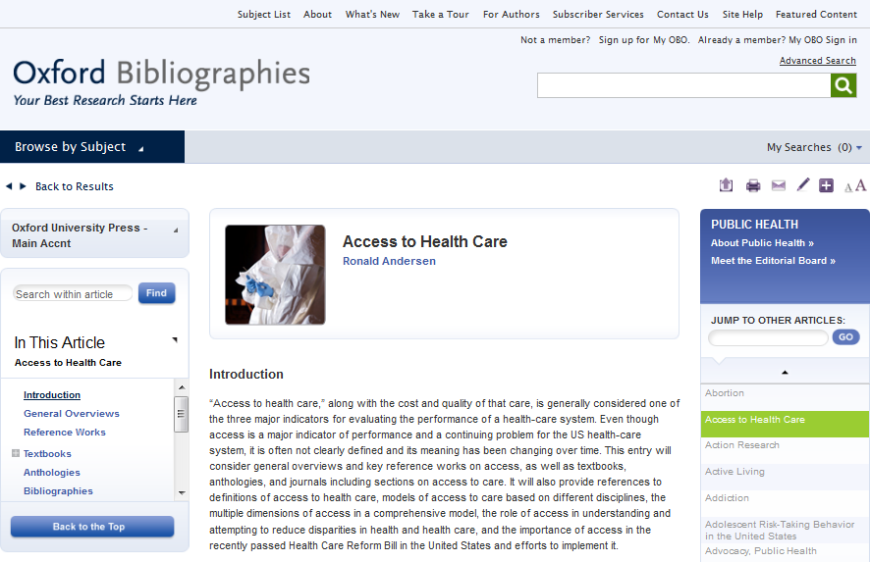
Каждая статья в Oxford Bibliographies снабжена прямыми рекомендациями и контекстной информацией, чтобы пользователи могли найти в точности те ресурсы, которые им нужны.

Slide 21
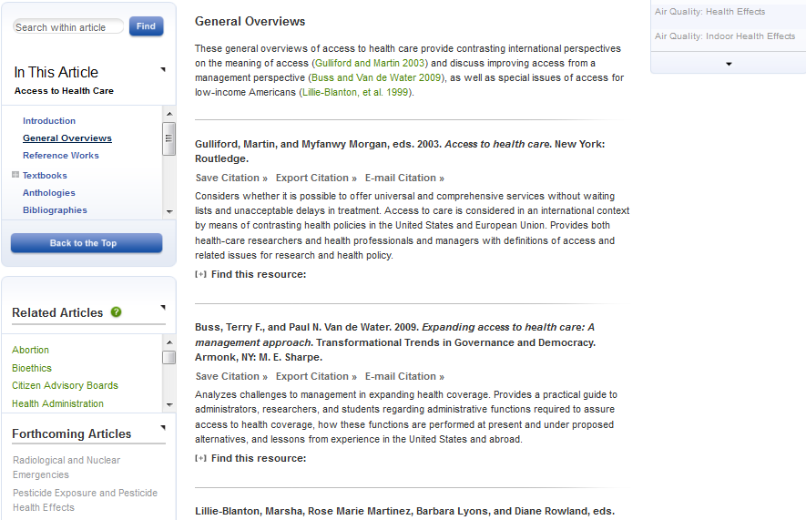
Каждая статья, написанная и отрецензированная ведущими учёными в своих областях, состоит из вводного текста и комментариев с последующим аннотированным списком ссылок на процитированные работы:

Slide 22
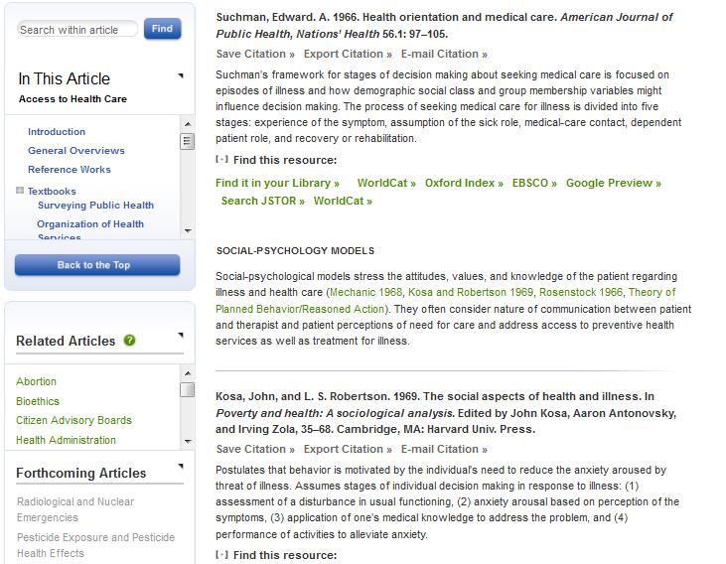
Значки OpenURL ведут на запись соответствующего ресурса в вашем библиотечном каталоге
Ссылки WorldCat приводят прямо на запись соответствующего ресурса в каталоге OCLC WorldCat.
Ссылки Google Books (где это возможно) ведут прямо на этот ресурс в Google Books.

Slide 23
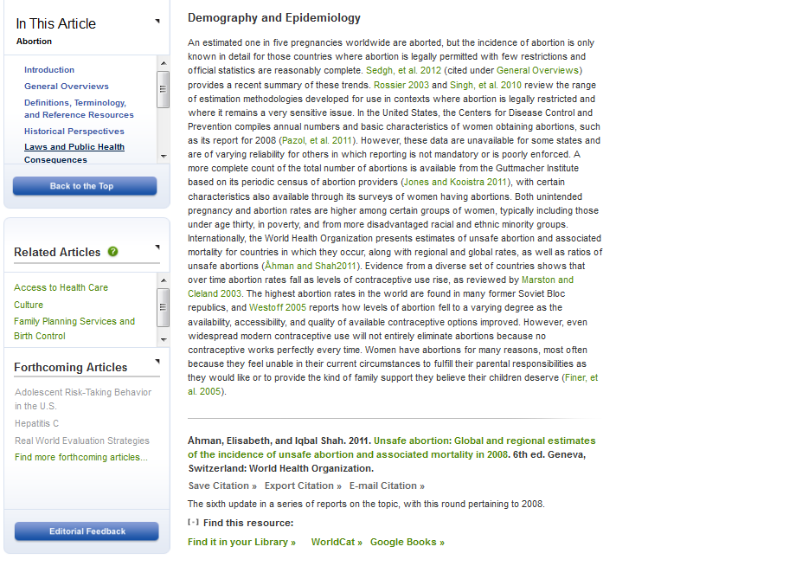
заголовки – определяют типы ресурсов и основные научные области
Экспертные комментарии вводят в контекст и дают рекомендации, ориентируя пользователя среди цитат
Ссылки на ресурсы, доступные в вашем библиотечном каталоге, OCLC WorldCat, Google Books и т.д.
Цитаты снабжены выборочным списком лучших и наиболее полезных ресурсов
Аннотации показывают, что включено в работу, и дают указания о том, как ресурс может способствовать поиску

Slide 24
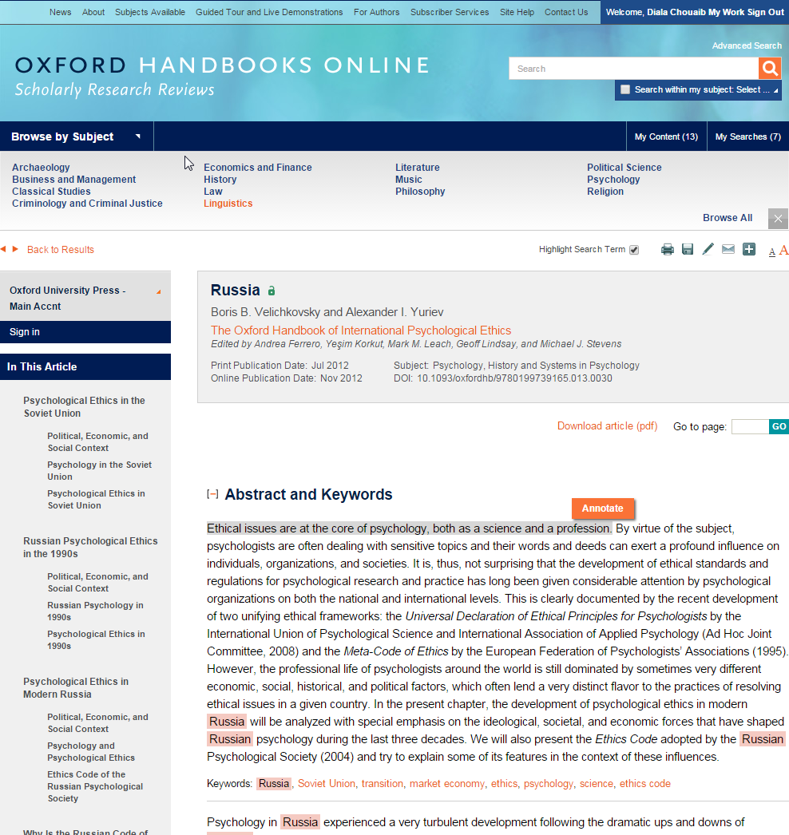
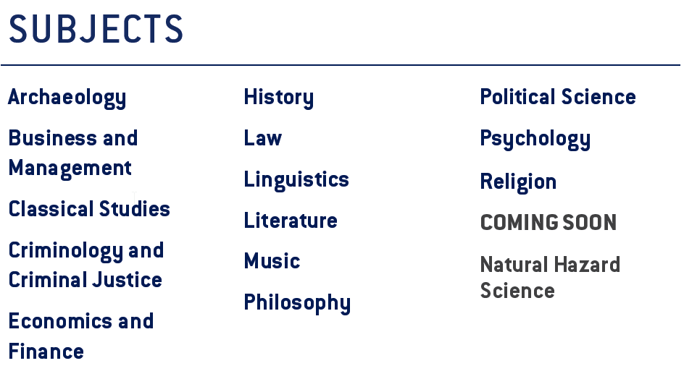

Oxford Handbooks Online
Explore the content
14 subject areas
Scholarly reviews of subjects in humanities and social sciences.
Articles are posted online as soon as they are ready. Extremely up to date
Notes:
14 subject areas
1- Scholarly reviews of subjects in humanities and social sciences.
2- Articles are posted online as soon as they are ready. Extremely up to date.
Points to highlight – annotate and existence of QR codes in printer friendly versions

Slide 25
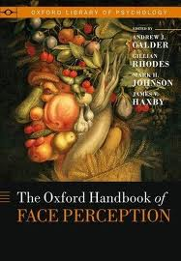
Oxford Handbooks Online
Archaeology
Business & Management
Classics
Criminology
Economics & Finance
History
Law
Linguistics
Literature
Music
Philosophy
Political Science
Psychology
Religion
Over 17 000 Chapters

Slide 26
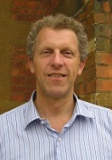


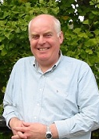









Editors in Chief and Editorial Boards
Chris Gosden Archaeology | Michael Hitt Business and Management | Michael Tonry Criminology and Criminal Justice | William Doyle History
Sally Thomason Linguistics | Colin Burrow Literature | Alexander Rehding Music | Sandy Goldberg Philosophy
Desmond King Political Science | Peter Nathan Psychology | Mark Juergensmeyer Religion | Markus Dubber Law
Gareth Williams
Classical Studies
Ensure accuracy, authority, and objectivity
Commissioning online-only peer reviewed articles
Expanding research in cutting edge topics
Ensuring comprehensive coverage of fast-moving disciplines

Slide 27
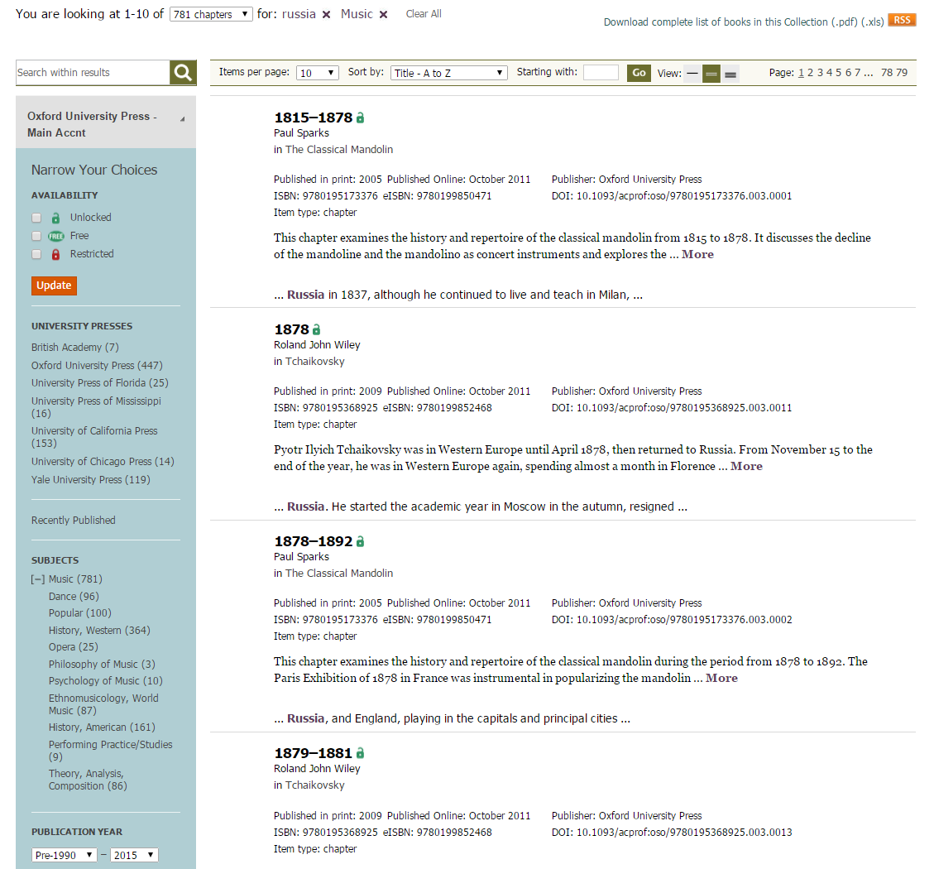
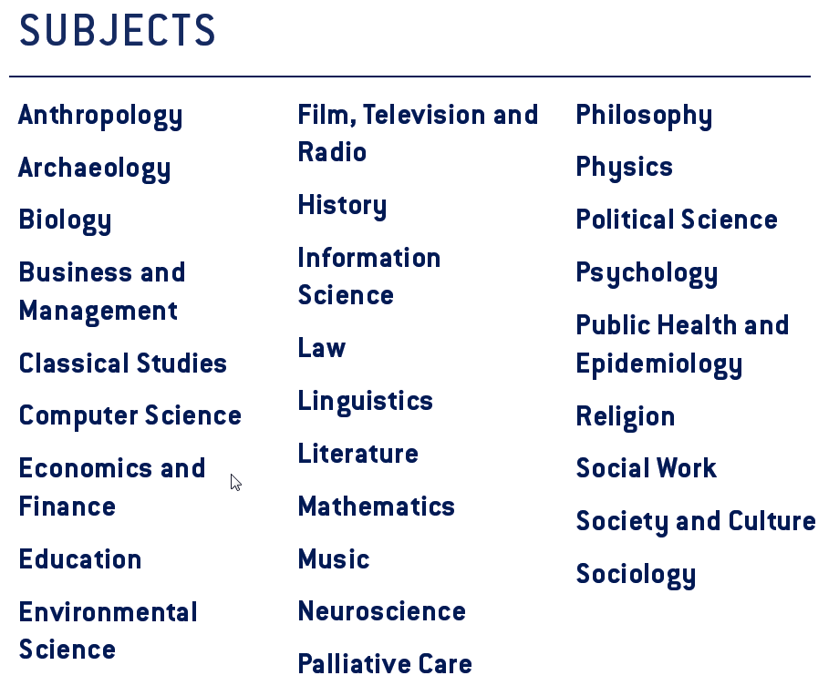
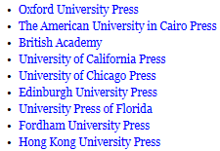
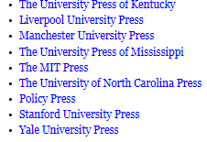
University Press Scholarship Online
Explore the content
Notes:
28 subject areas
1- Information across 18 partner presses as shows on the left column of the page.
2- Monographs

Slide 28


Presentation Outline
Oxford Scholarship Online
University Press Scholatship Online
Notes:
This presentation introduces the history of one of our flagship online products – Oxford Scholarship Online and uses it as a case study to take you behind the scenes when creating and digitising an online product, from the publisher perspective.
It also offers up three key challenges that we meet when digitizing our academic monographs.
There will be opportunity at the end of the presentation to reflect on the challenges and discuss the future of ebooks, but if you have any questions in the meantime, or you need me to explain anything further, or slow down, please do speak out.

Slide 29
Presentation Outline
Oxford Scholarship Online
University Press Scholatship Online
12,000 Books in 20 discilplines
19,000 Books in 29 discilplines
Notes:
This presentation introduces the history of one of our flagship online products – Oxford Scholarship Online and uses it as a case study to take you behind the scenes when creating and digitising an online product, from the publisher perspective.
It also offers up three key challenges that we meet when digitizing our academic monographs.
There will be opportunity at the end of the presentation to reflect on the challenges and discuss the future of ebooks, but if you have any questions in the meantime, or you need me to explain anything further, or slow down, please do speak out.

Slide 30
University Press Scholarship Online (UPSO)
Participating presses:
Oxford University Press The American University in Cairo Press
University of Chicago Press University of California Press
Edinburgh University Press University Press of Florida
Fordham University Press Hong Kong University Press
The University Press of Kentucky Manchester University Press
Policy Press The MIT Press
Stanford University Press

Slide 31
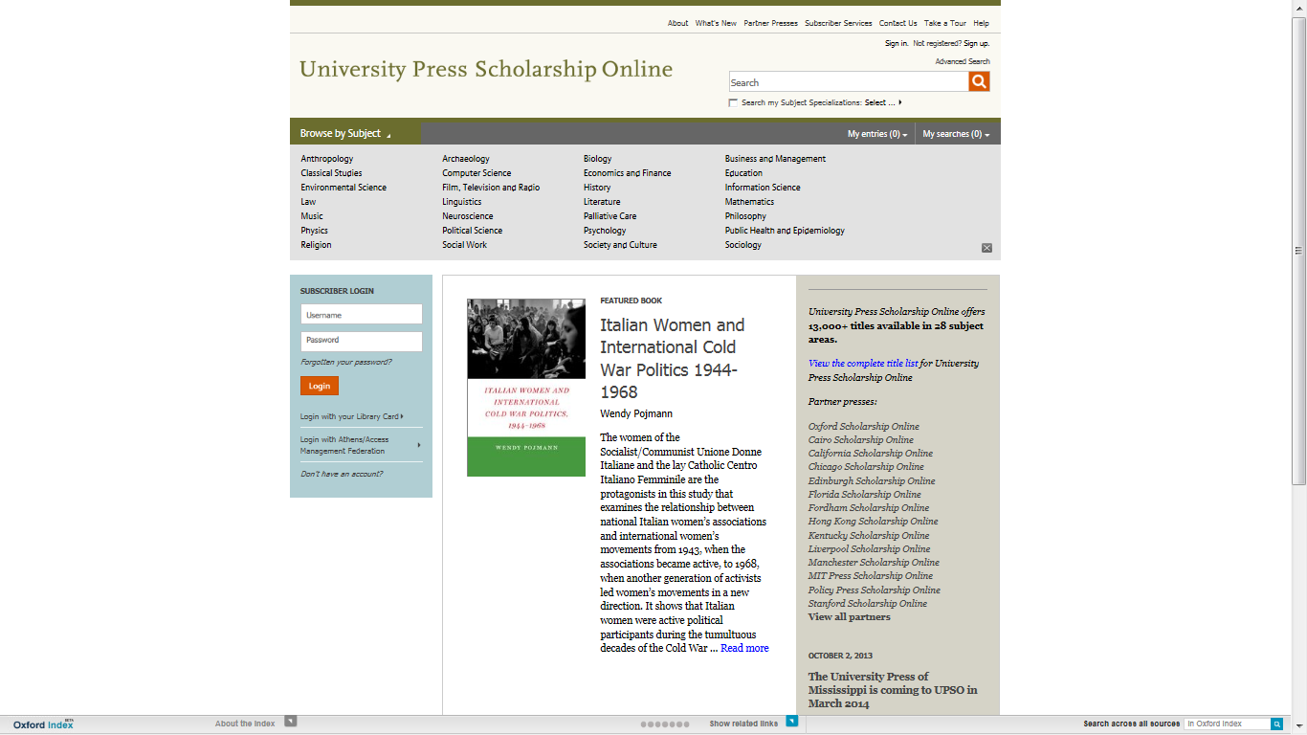

Slide 32
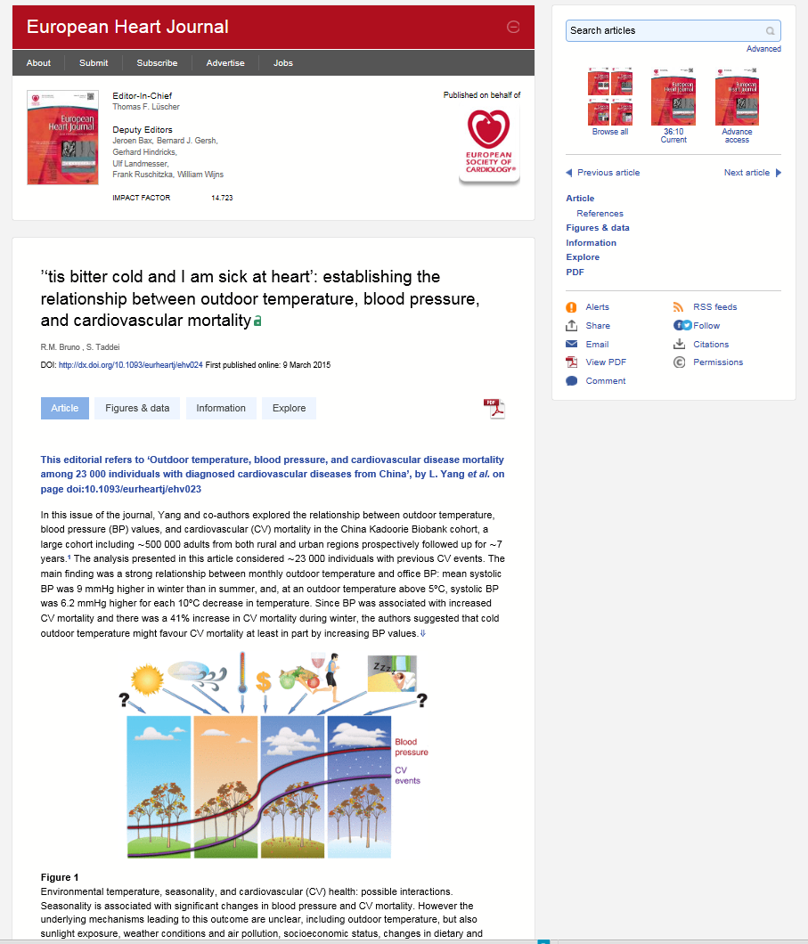
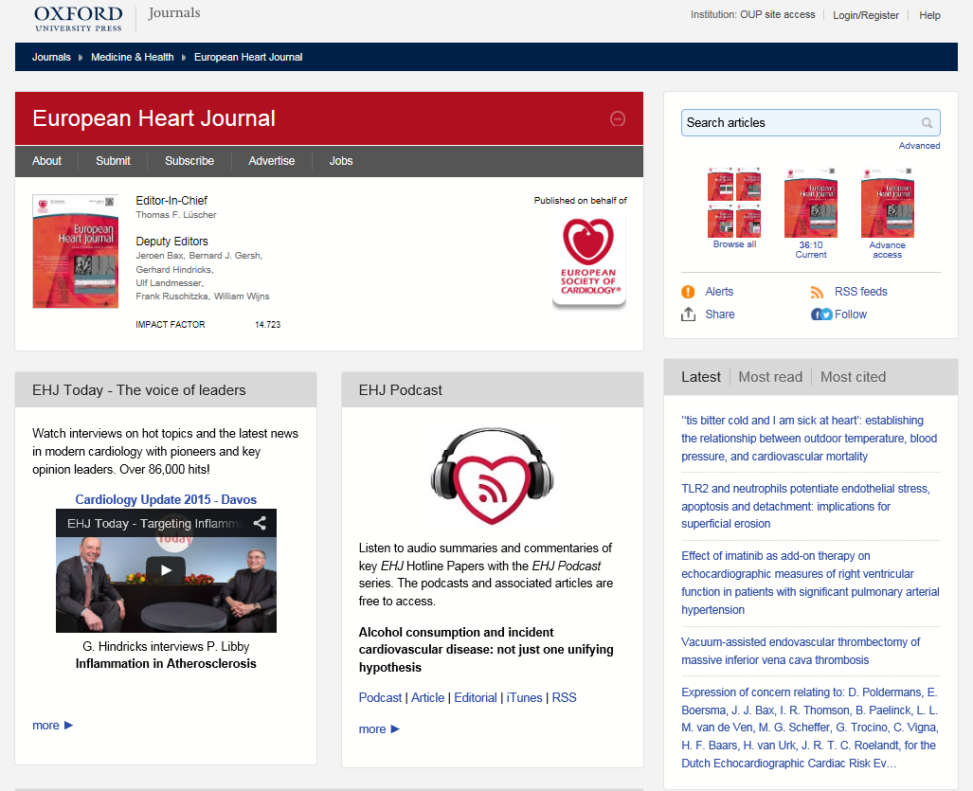
Oxford Journals Online
Transitioning to the new site
Notes:
6 subject areas
New feel, more user friendly
Things to highlight – downloading images to powerpoint or as an image. Links to library catalogue. Extensive alerting to keep the researcher up-to-date re the author’s publications and new articles in a search field, etc.

Slide 33
OUP Journal Joiners
Publishing partnerships
We consider our role in the academic community to extend to the publishing we do on behalf of societies
We publish over 300 journals in law, medicine, the humanities, social sciences, life sciences, and mathematics and physical sciences – two-thirds of which are published in partnership with learned and professional societies
Societies want to publish with OUP because we understand and can deliver on shared strategic goals for their titles

Slide 34
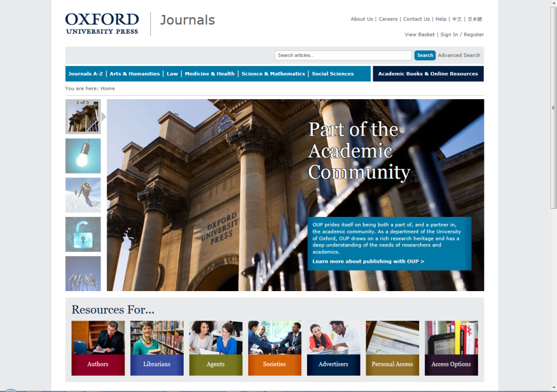
Oxford University Press (OUP) publishes the highest quality journals and delivers this research to the widest possible audience.
We achieve this by working closely with our society partners, authors, and subscribers in order to provide them with publishing services that support their research needs.
www.oxfordjournals.org

Slide 35
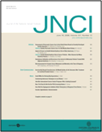
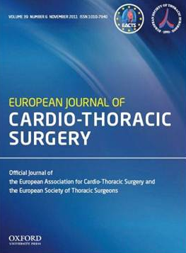
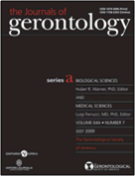
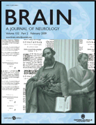



The Medicine Collection
  Oncology, cardiology, neurology, epidemiology, reproductive medicine, rheumatology, anesthesia, gerontology, & public health
The Life Sciences Collection
  Molecular and computational biology, plant science, marine biology, and behavioral ecology

Slide 36
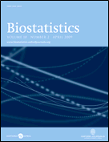
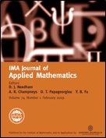


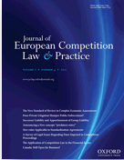
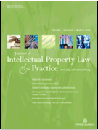
The Mathematical & Physical Sciences Collection
Pure and applied mathematics, radiation science
Also coverage of more niche areas such as biostatistics and mathematical physics, management, and medicine
The Law Collection
general academic and practitioner law titles, and those dedicated to more specialized areas such as medical & environmental law, criminology, intellectual property, & policing

Slide 37
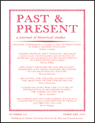
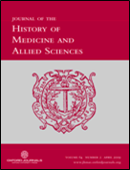
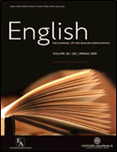
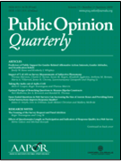

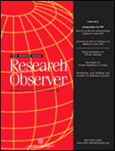
The Humanities Collection
  History, philosophy, literature, religion, art, and music
The Social Sciences Collection
  Economics, finance, business, global development, religion, and social politics

Slide 38
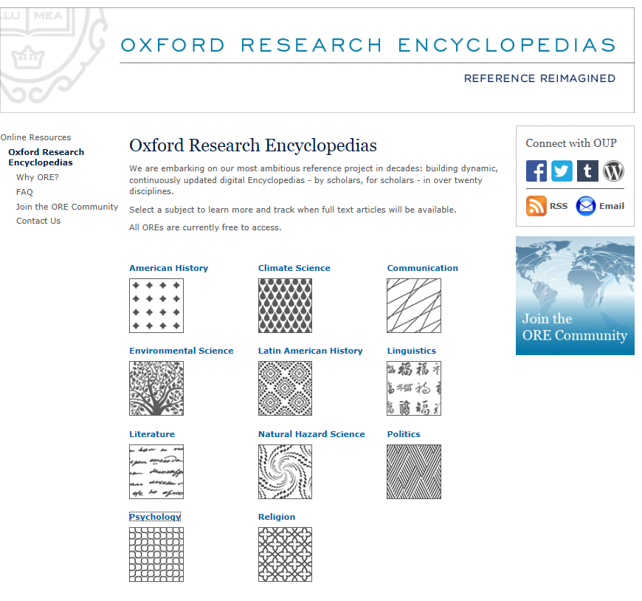
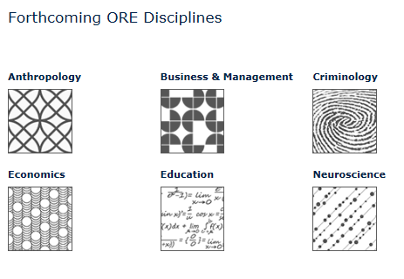
Oxford Research Encyclopaedias
Explore the content

Slide 39
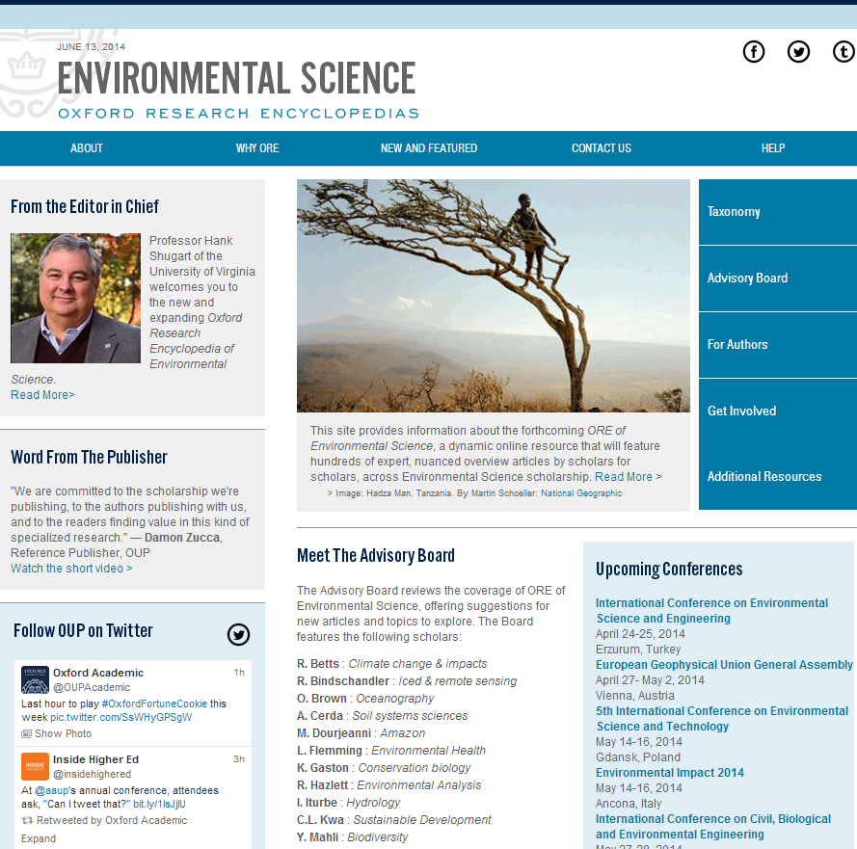
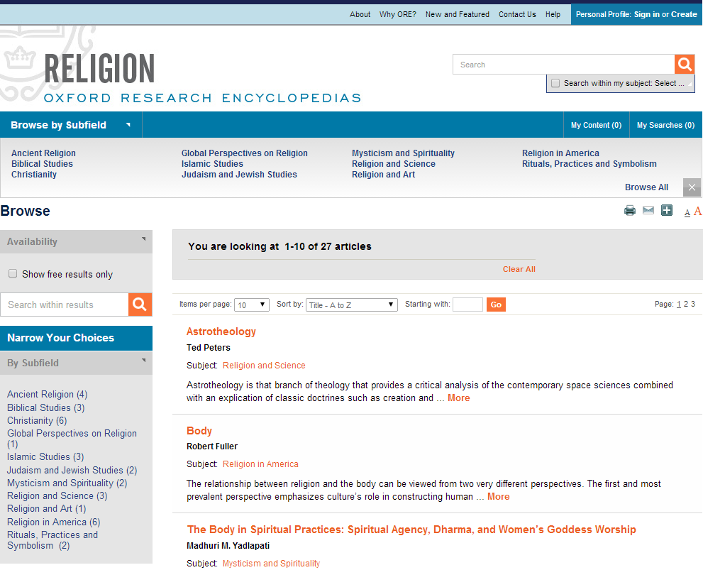
Oxford Research
Encyclopedias
Oxford’s online platform, delivering article summaries and full-text articles
Screenshots

Slide 40

Discoverability
Search across 2.5 million abstracts from Oxford University Press – scholarly essays, journal articles, and reference works
Freely available abstracts make discovery of Oxford’s content via Google and other search engines easier
Overview pages with links to additional resources

Slide 41
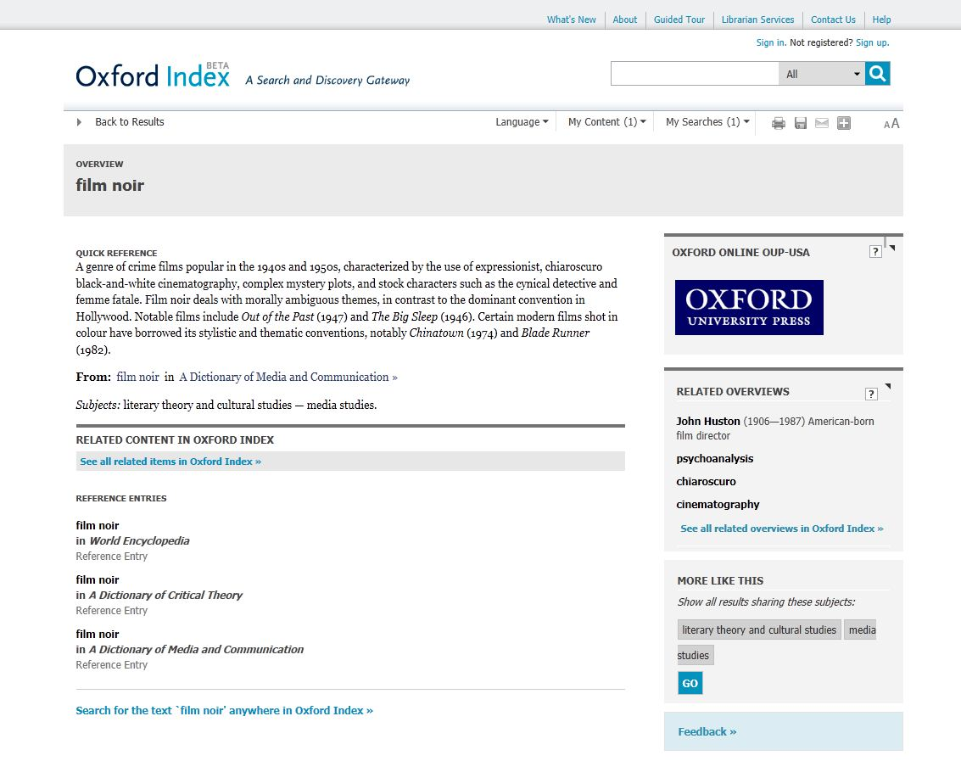
Discoverability
Free searching and content previews
Filters – such as subject or content type
Succinct entries on a single topic
Freely available abstracts
The Oxford Index Underbar generates related content links

Slide 42
How to get published with international journals?

Slide 43
Who is publishing with OUP from Tomsk?
 | Year | Manuscript title | MS Category | Title | Forename | Surname | Institution
Philosophical Quarterly | 2015 | Scottish Philosophy in the Nineteenth and Twentieth Centuries | Book Review | Dr. | Elena | Fell | Tomsk Polytechnic University
International Journal of Lexicography | 2015 | Electronic dictionary of folk primety | Article | Dr. | Natalia | F.Kartofeleva | National Research Tomsk State University
Aesthetic Journal | 2013 | Paul Crowther Phenomenologies of Art and Vision | Book review | Dr. | Elena | Fell | Tomsk Polytechnic University

Slide 44

Before you start………….
You must have a clear topic
or topics to be reviewed,
what is your research
question?

Slide 45
Ideas where to start
As well as ‘traditional’ research…
Are you working on a Doctoral or Master’s thesis?
Have you completed a project which concluded successfully?
Are you wrestling with a problem with no clear solution?
Do you have an opinion or observation on a subject?
Have you given a presentation or conference paper?
If so, you have the basis for a publishable paper

Slide 46

Editors are looking for “something new and preferably surprising” according to Dr. Peter Smith, a Cambridge philosopher and former editor of Analysis, the philosophical journal.
NEW IDEAS
NEW IDEAS
NEW IDEAS

Slide 47
Be Careful:
There are 1,000,000’s of published studies. You need to MASTER your topic: be aware of works completed by others, updates or/and be ready to answer questions or summarize it.

Slide 48
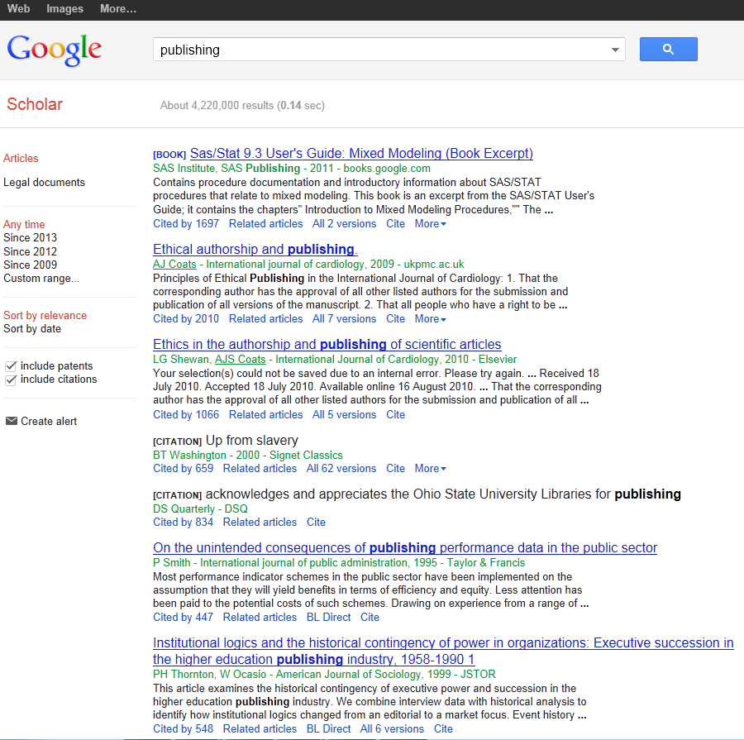
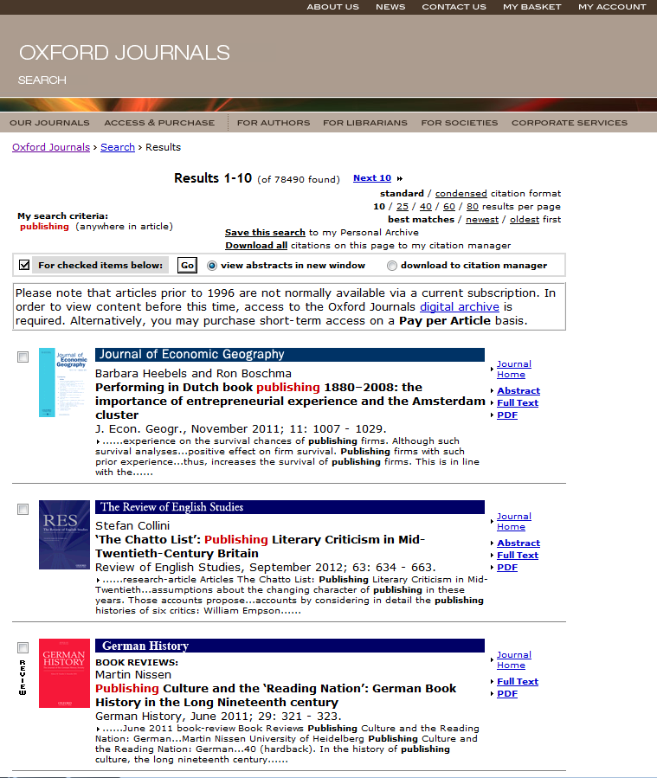
References:

Slide 49
Oxford Bibliographies Online
OBO is a library of discipline-focused, online guides to the essential literature across a broad range of subject areas.
Each OBO article, written and reviewed by top scholars in the field, is rich with citations and annotations, expert recommendations, and narrative pathways through the most useful and important works on the topic in question.
Intuitive linking throughout quickly delivers the user from a citation to full-text content, whether online or available through a library’s catalog.
“We are drowning in information, while starving for wisdom. The world henceforth will be run by synthesizers, people able to put together the right information at the right time, think critically about it, and make important choices wisely.”
— E.O. WILSON
Notes:
Quote from Edward Osborne Wilson Harvard University professor and 2 time winner of the Pulitzer prize.
27 subject areas available; launching 10-12 new subjects each year
Every subject area has an Editor-in-Chief and Editorial Board, and each article receives multiple peer reviews and board vetting
50-100 articles at launch per subject (equivalent to a 4-volume print encyclopedia)
Updated regularly, with 50-75 articles added per year to each subject area. Updates will also include revisions to existing articles.
It is selective, rather than exhaustive; expert recommendations with critical supportive text and annotation are provided to help cut down on time needed for preliminary research
Articles contain recommendations for scholarship at all levels, from encyclopedias and textbooks to journal articles and data sets – whether you’re starting a research paper, studying for qualifying exams, or preparing a syllabus, OBO is the perfect starting place
Includes indexing of non-print material, especially online resources

Slide 50
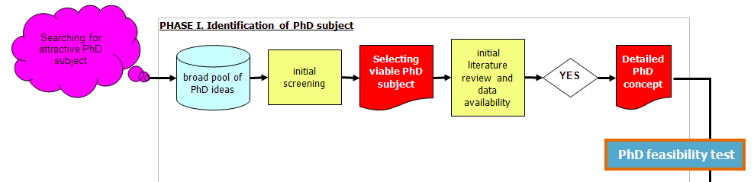
Our Focus

Slide 51
Initial literature review: The 5 X 5 principle
Identify 5 top peer refereed academic journals focusing on
your specific subject
Identify 5 top internationally recognized books or collective
works on your specific subject
Identify 5 top academic research centres specializing in
your subject
Identify 5 most renowned professors in your narrow field
(„gurus”)
Identify 5 top regular international academic conferences
covering your subject

Slide 52

Think of a literature review as a jigsaw puzzle

Slide 53
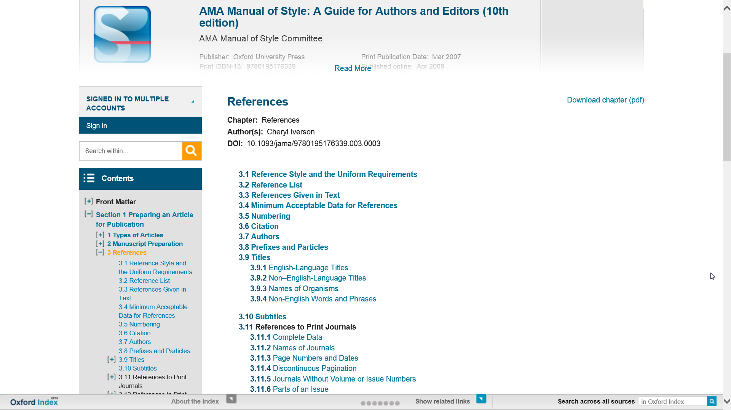

Slide 54
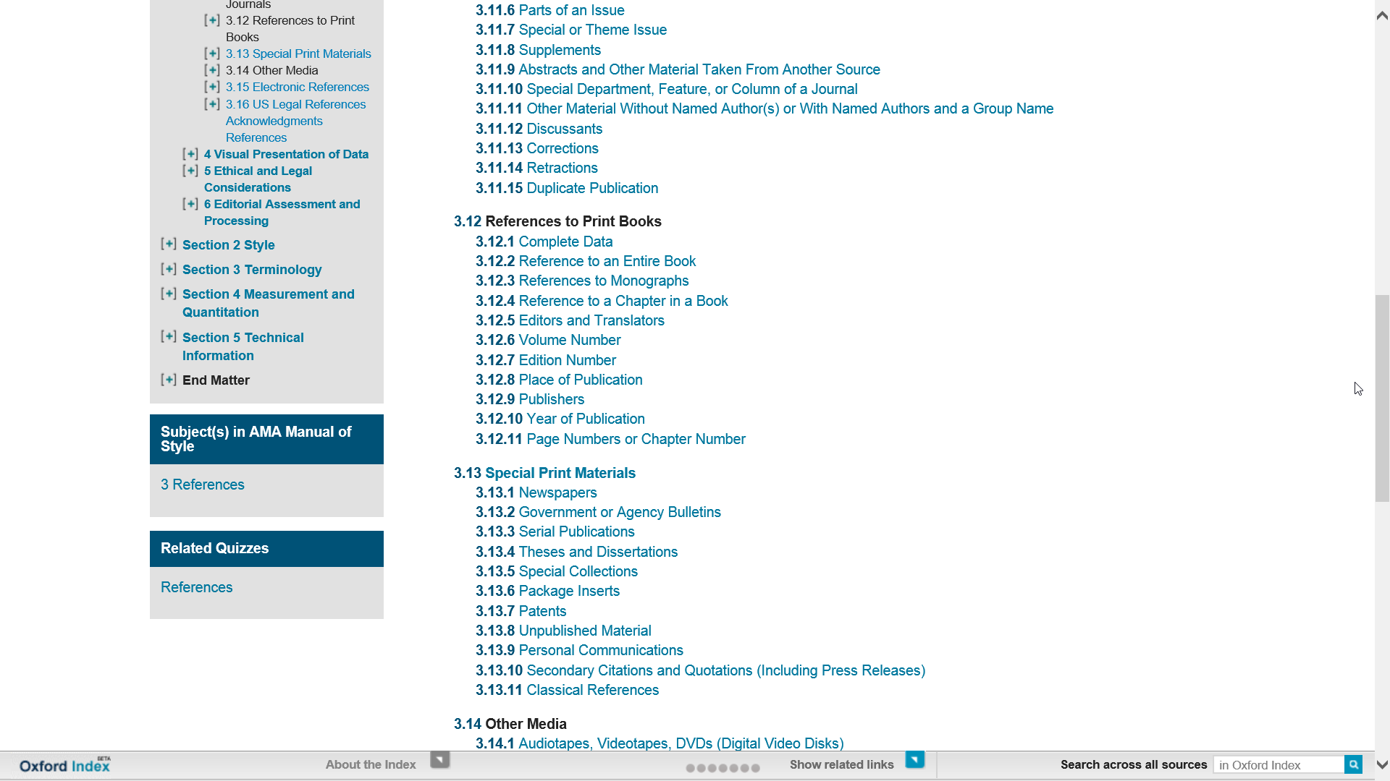

Slide 55


Slide 56

Which journal to go for?

Slide 57
Criteria You Might Look At:
Rankings (example Thomson Reuters Impact factors; the Association of Business Schools ABS etc.)
Number of downloads (utility)
Dissemination of journal (where it is read)
Links to societies/associations
Relevance of content and publishing ethos
International

Slide 58
Questions to Ask Yourself
When Choosing:
What are your most important factors when choosing a journal?
Which resources do you use to research the journals you publish in?
Which rankings do you use? How important are they?
Who do you ask for advice?
What is the best journal in your field? Why?

Slide 59

PROCESS!!!!!
Putting A and B together to build up your work

Slide 60
Surviving peer review
Not always straight forward proccess

Slide 61

Research is all about peer review
You need to avoid a desk reject
You may need to revise and resubmit
You will almost certainly need to alter your paper

Slide 62
The Process
Submission is an important step on the road to being published
Reviewers are selected for their expertise by the Editors
They do sometimes make mistakes and their opinions may not be valid
But generally they raise genuine concerns about the work – conceptualization, execution and/or interpretation of the work

Slide 63
The Process
Their comments are aimed at maintaining the quality of papers publish in the journal, the overall journal reputation and ultimately at improving your work to attain a high standard of academic writing.

Slide 64
Process Conclusion:
Identify a few possible target journals but be realistic
Follow the Author Guidelines: scope, type of paper, word length, references style, etc.
Find where to send your paper (editor, regional editor, subject area editor) …
… and how to send it (email, hard copy, online submission)
Send an outline or abstract to editor: is it suitable? how can it be made so?
Read at least one issue of the journal

Slide 65
www.oxfordjournals.org

Slide 66


Slide 67
www.oxfordjournals.org

Slide 68


Slide 69


Slide 70


Slide 71


Slide 72


Slide 73
What makes a good paper?
HINT: Editors and reviewers look for …
Originality – what’s new about subject, treatment or results?
Relevance to and extension of existing knowledge
Research methodology – are conclusions valid and objective?
Clarity, structure and quality of writing – does it communicate well?
Sound, logical progression of argument
So what?’ factors!
Recency and relevance of references
Adherence to the editorial scope and objectives of the journal
A good title, keywords and a well written abstract

Slide 74
Co-authorship?
With supervisor, different departments or institutions
Exploits individual strengths
Especially useful for cross-disciplinary research
Demonstrates the authority and rigour of the research
Increases potential pool of citations
But remember
Ensure paper is edited so that it reads as one voice
Identify the person responsible for closing the project
Agree and clarify order of appearance of authors

Slide 75
Peer Review:
Peer Review is important to assess your work before submitting it.
Have fellow colleagues, tutors, scholars look at your work and give you feedback to avoid desk rejection. You do not want to be refused by appearing uninformed concerning your submission.
Always expect that you would have to amend, alter and revise your paper to submit a more accurate version.

Slide 76
Plagiarism and referencing
Plagiarism (from the Latin plagium meaning ‘a kidnapping’) is the act of taking someone else’s work and pretending it is yours. It is considered fraud!
It isn’t always detected in peer review but electronic tools can help

Slide 77
Revising
A request for revision is good news!
  You’ve avoided a desk reject and you are in the publishing cycle
  Nearly every published paper is revised at least once
  So now, close the deal!
Acknowledge the editor and set a revision deadline
Clarify if in doubt – ‘This is what I understand your comments to mean…’
Meet the revision deadline
Attach a covering letter showing how you met the reviewers’ requests (or if not, why not)

Slide 78
Dealing with the comments:
Answer as completely as possible
Answer politely, be tactful and not with emotive language
Answer with evidence
If you feel the reviewer has misunderstood then address the point with a good argument explaining why the reviewer is mistaken
  It may be the reviewers are conflicted on a point
  It is ok to use one reviewer to argue against another

Slide 79


Slide 80

In case of rejection:

Slide 81


Slide 82
If your article is rejected
Ask why, and listen carefully!
Most editors will give detailed comments about a rejected paper. Take a deep breath, and listen to what is being said
Try again!
Try to improve the paper, and re-submit elsewhere. Do your homework and target your paper as closely as possible
Don’t give up!
At least 50% of papers don’t get published. Everybody has been rejected at least once
Keep trying!

Slide 83
How to sell your work
Use a short descriptive title containing main keyword – don’t mislead
Write a clear and descriptive abstract containing the main keywords and following any instructions as to content and length
Provide relevant and known keywords – not obscure new jargon
Make your references complete and correct – vital for reference linking and citation indices
All of this will make your paper more discoverable which means more dissemination and possibly more citation

Slide 84


Slide 85
YOU DID IT!!!!!!!

Slide 86
OUP
SUPPORTING ACADEMIC RESEARCH

Slide 87
EPIGEUM
The leading global provider of online training courses designed to help universities and colleges transform their:
  teaching
  research
  studying
  leadership and management
Courses designed for teachers, researchers, and students
Courses are developed by way of collaboration and then shared by subscription

Slide 88

History
Where did Epigeum originate?
Originally a spin-out from Imperial College London…

Slide 89

Facts
Epigeum in numbers
Founded in 2005
78 courses
Used by 230 universities
In 27 countries
And 36% of the top 100 global universities
Including 95% of the UK Russell Group universities

Slide 90

Content by sector
Teaching
5 Programmes in total, key courses:
  University college teaching (2012)
  Teaching online (2012)
  Teaching and assessment for Medical educators (2015)
  Teaching & assessment for allied health educators (2015)

Slide 91

Content by sector
Research
9 Programmes in total, key courses:
  Research Integrity (2012)
  Research skills master programme (2013)
  Supervising Doctoral studies (2014)
  Statistical methods for research (2014)

Slide 92

Content by sector
Studying
6 Programmes in total, key courses
  Avoiding Plagiarism (2014)
  English for Academic studies (2015)
  Academic success: skills for learning, skills for life (2015)

Slide 93

AMA Manual of Style
A Guide for Authors and editors
(руководство для авторов и редакторов)
Краткая история издания
Первое издание редакционного руководства для научных журналов AMA появилось в октябре 1962; в нём было 68 страниц и предназначалось оно, в первую очередь, для штатных сотрудников, и лишь во вторую для авторов. Издание росло медленно, но уверенно: от 90 страниц во втором издании, вышедшем в свет в 1963, до 154 страниц в шестом, изданном в 1976.
Восьмое издание дало начало сегодняшней «традиции» — комитету из 10 профессиональных редакторов из JAMA и Archives Journals, ответственных за контент и получение внешних рецензий (peer review) по всем разделам.
В 10 издании, выпущенном Oxford University Press в 2007, руководство продолжило наращивать объём, который составляет сейчас 1032 страниц.

Slide 94

M
AMA Manual of Style

Slide 95

What is the AMA Manual of Style?
A must-have guide for anyone involved in medical or scientific publishing
An essential, one-stop resource providing quick access to authoritative information.
Everything you need to produce well-organized and clear manuscripts

Slide 96



Linking from course packs and reading lists
To add a chapter to an online course pack or reading list, COPY and PASTE the DOI to the end of the standard URL prefix. Eg. 10.1093/jama/9780195176339.001.0001
Students who click on this URL will be taken straight to this section
DOIs are unique and permanent so you don’t need to worry about broken links

Slide 97

«По-настоящему позитивный опыт. Меня более чем удовлетворило редактирование моей статьи – особенно мне понравились скорость работы и дружеская манера общения».
www.oxfordlanguageediting.com

Slide 98

Наша услуга
Услуга англоязычного редактирования для иностранных ученых позволяет им получить свой текст на превосходном английском языке.
Мы редактируем журнальные рефераты и статьи, письма, доклады и книги по всем научным дисциплинам.
Услуга Oxford Language Editing адресована ученым во всем мире –независимо от того, где именно они хотят публиковаться.

Slide 99
Наши редакторы
Профильная команда из 150 редакторов-фрилансеров
Носители английского языка
Высокая квалификация в своих дисциплинах
Убедительный список публикаций
Предыдущий опыт редактирования

Slide 100
Серьезное отношение к обязательствам перед авторами
Высококачественное, тщательное редактирование
Срок выполнения работы – семь рабочих дней
Индивидуальный и дружеский подход со стороны профильной команды OLE
Англоязычное редактирование по всем дисциплинам
Повышение вероятности опубликования работы

Slide 101
Наш процесс редактирования
Исправление грамматических, пунктуационных и других языковых ошибок
Использование высококачественного английского языка
Обеспечение ясности изложения
Переформулирование предложений для улучшения восприятия
Предоставление инструментов и рекомендаций по улучшению качества
Отточенные формулировки ключевых идей
Улучшение форматирования
Указание на ошибки в тех местах, где изложение фактов представляется неточным

Slide 102
www.oxfordlanguageediting.com

Slide 103
Reference Publishing at
Oxford University Press

Slide 104



















Reference at Oxford University Press
What is subject reference?
Compilation of factual information and sophisticated contextual analysis designed to help researchers save time and find other reliable sources of information
  Full spectrum print and digital publisher, but focus is digital
  16 online subscription products
  4 million visits annually and growing
  5,000 authors published and growing
  62 countries and growing

Slide 105

  The Information Overload Problem
  Difficult to keep up with developments in the field
  Labor-intensive to start research in unfamiliar areas
  Slows productivity on research projects
  Guiding students is major challenge.

Slide 106
How can academic reference help?
Entryway into scholarly and scientific research in unfamiliar
areas
Trustworthy guidance based on the considered judgments of
experts
Provides pathways on to further research
A framework of knowledge within that field of inquiry

Slide 107

Mobilizing the community of experts

Slide 108



Digital Reference at Oxford University Press
Audience of scholars, scientists, and university students
Long-form, peer-reviewed content that supports academic research and learning
Deep commitment to excellence, scholarship, and expertise
Focus on beginning stages of the research journey.
Digital; continuously updated; by invitation

Slide 109
Digital publishing model
Appoint an Editor-in-Chief and Editorial Board
Develop conceptual framework
Invite authors
Peer-review contributions
Regular review of progress to determine new topics and update priorities
Commission new articles or updates based on user feedback

Slide 110

Global network of research

Slide 111
Oxford Bibliographies

Slide 112



Oxford Bibliographies: What is it?
Guides research through growing mass of academic output
Reproduces the experience of asking an expert for recommendations
By invitation, only online, double peer-review
Helps researchers save time and increase productivity

Slide 113

Headings concisely identify the type of resource or area of scholarship
Commentary provides context and recommendations to guide users through the cited sources
Citations provide selective list of best and most useful resources available
Annotations provide more information about each work and guidance on why it is important or useful

Slide 114
Oxford Bibliographies: International authorship
How to tap into global network of authors?
Not well known outside US and UK
Writing is in English
Reference is not considered scholarship
Online-only publication deters some authors
Making connections
By the numbers
41 subjects
8,500 articles signed
  5,325 articles published
  29 million words (65 printed volumes)
  542,758 recommended sources
  6,000 authors
  170 academic board members
  54 countries

Slide 115
Research Encyclopedias

Slide 116

Oxford Research Encyclopedias
Continuously updated encyclopedias in 20 disciplines
Deliver in-depth interpretative overviews
Written and vetted by scholars for scholars and students
Map the entirety of a field of inquiry; evolve as the field evolves
Direct research journeys to other relevant trusted content

Slide 117






Disciplines Covered

Slide 118
Oxford Research Encyclopaedias
Explore the content

Slide 119


Oxford Research
Encyclopedias

Slide 120

Any Questions…
Marcin Dembowski
marcin.dembowski@oup.com

